Slide 1
Boosting Algorithms
Ada Boost
XG Boost
LG Boost

Slide 2
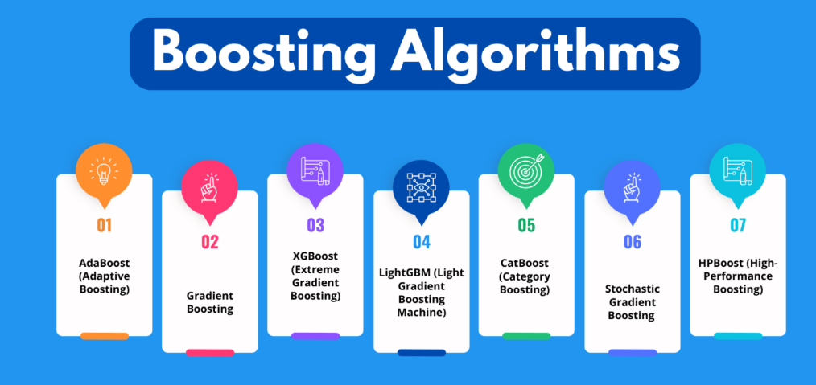
Different – Boosting Algorithms
Boosting is a powerful ensemble technique in machine learning that aims to create a strong classifier from a set of weak learners (typically decision trees). The idea is to train models sequentially, where each new model tries to correct the errors of the previous ones.

Slide 3
Ada Boost Algorithm
AdaBoost (Adaptive Boosting)
is a boosting algorithm that combines multiple weak learners (often decision stumps—trees with one split) into a strong classifier by focusing on the errors of previous learners. Each new model is trained to fix the mistakes of the las
Assigns weights to instances.
Misclassified instances get higher weights.
Combines the weighted predictions of weak learners.

Slide 4
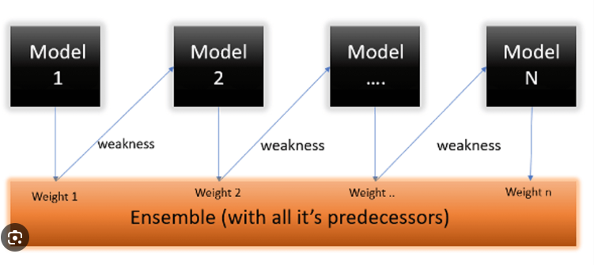

Slide 5
Advantages
Advantage | Description
Improves Weak Learners | Combines many weak models into a powerful ensemble with good accuracy.
Simple to Implement | Easy to code and understand; available in most ML libraries (e.g., sklearn).
Focuses on Hard Examples | Prioritizes misclassified points, improving overall performance.
No Feature Scaling Needed | Works well without normalizing or standardizing data.
Feature Importance | Provides insights into which features are most useful.
Reduces Bias | Helps reduce both bias and variance when used correctly.

Slide 6
Disadvantages
Disadvantage | Description
Sensitive to Noisy Data | Focuses heavily on misclassified points, which may include noise or outliers.
Sequential Training is Slow | Learners are trained one after another, so it’s not parallelizable and can be time-consuming.
Hard to Tune | Sensitive to hyperparameters like learning rate and number of estimators.
Not Ideal for Complex Models | Works best with simple learners; using complex base models may lead to overfitting.
Poor with Imbalanced Data | Struggles with class imbalance without additional techniques (e.g., sampling).
Originally for Binary Classification | Extensions exist, but it’s naturally suited for binary tasks. Multi-class support is less efficient.

Slide 7
XG Boot Regression / Gradient Boost
XGBoost (Extreme Gradient Boosting)
An efficient implementation of Gradient Boosting.
Features: regularization, parallel processing, handling missing data.
Often used in Kaggle competitions.
Trains models sequentially, each one trying to reduce the error (residuals) of the previous model.
Optimizes a loss function (like MSE for regression) using gradient descent.
Base learners are usually decision trees (shallow trees)

Slide 8
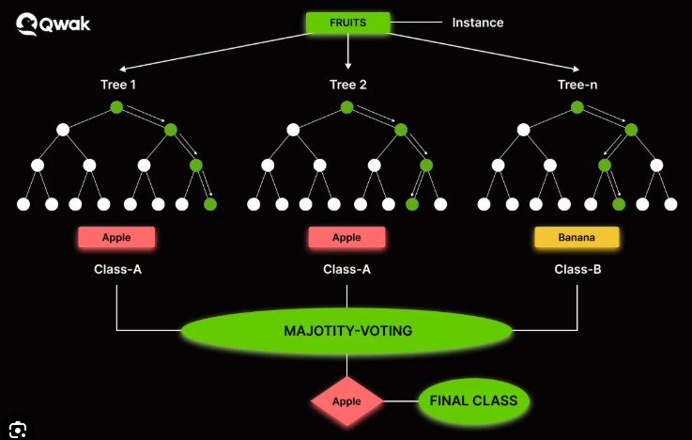

Slide 9
Advantages/Disadvantages
Advantages:
High accuracy.
Can handle complex nonlinear relationships.
Works well on small-to-medium datasets.
Disadvantages:
Can be slow to train.
Sensitive to hyperparameters.
Risk of overfitting without regularization.

Slide 10
LG Boosting /light boosting
LightGBM (Light Gradient Boosting Machine)
Faster and more efficient than XGBoost.
Uses histogram-based algorithms and leaf-wise tree growth.
LightGBM is a gradient boosting framework developed by Microsoft, designed for fast, efficient, and scalable training. It is especially powerful for large datasets and high-dimensional data.
Leaf-wise tree growth (with depth limits): More accurate than level-wise growth used in traditional gradient boosting.
Histogram-based splitting: Converts continuous values into discrete bins, reducing computation time and memory usage.
Supports parallel and GPU training.
Natively supports categorical features.

Slide 11
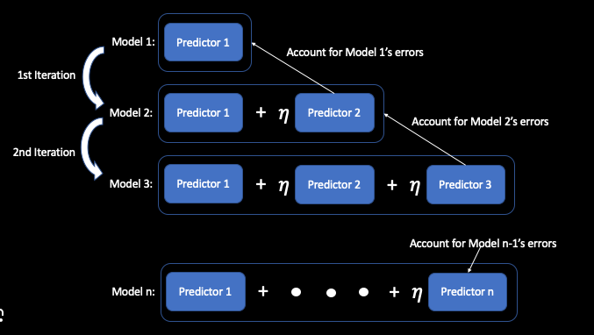

Slide 12
Advantages
Advantage | Description
High Speed & Efficiency | Much faster training compared to XGBoost or traditional GBMs due to histogram and leaf-wise techniques.
High Accuracy | Leaf-wise growth leads to better splits and lower loss, often resulting in better performance.
Handles Large Datasets Well | Scales well to millions of rows and high-dimensional data.
Supports Categorical Features | Can natively process categorical variables without one-hot encoding.
Lower Memory Usage | Efficient use of memory, suitable for large datasets.
Supports GPU Acceleration | Can be trained using GPUs for even faster performance.

Slide 13
Disadvantages
Disadvantage | Description
Can Overfit | Leaf-wise growth may cause overfitting, especially on small datasets.
Harder to Interpret | More complex models can be difficult to explain compared to linear models or decision trees.
Sensitive to Parameters | Needs careful tuning (e.g., num_leaves, min_data_in_leaf, max_depth) to avoid overfitting.
Not Ideal for Small Data | May perform worse than simpler models like Random Forest or AdaBoost on small datasets.
Categorical Handling Not Always Plug-and-Play | While it supports categorical data, sometimes preprocessing still improves performance.

